Slide 1
Introduction to Computer Simulation of Physical Systems (Lecture 3) Simulating Particle Motion
PHYS 3061

Slide 2
Clearly we have to sample many N step walks
because in general, each walk will give a different outcome.
We need to do a Monte Carlo simulation many times and average over the results to obtain meaningful averages.
Each N-step walk is called a trial.
How do we know how many trials to use?

Slide 3
The simple answer is to average over more and more trials until the average results don’t change within the desired accuracy.
The more sophisticated answer is to do an error analysis similar to what we do in measurements in the laboratory.

Slide 4
The more difficult parts of a program to simulate random walks are associated with bookkeeping.
The walker takes a total of N steps in each trial and the net displacement x is computed after every step.
Our convention will be to use a variable name ending in Accumulator (or Accum) to denote a variable that accumulates the value of some variable.
In next page, we provide two classes to be used to simulate random walks.

Slide 5
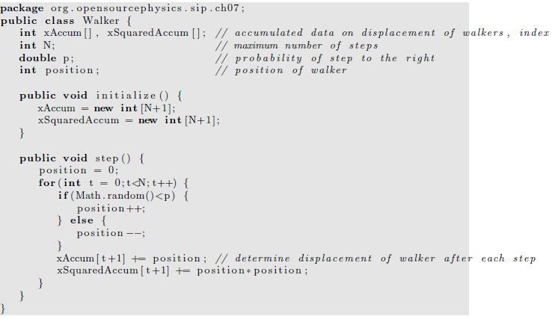

Slide 6
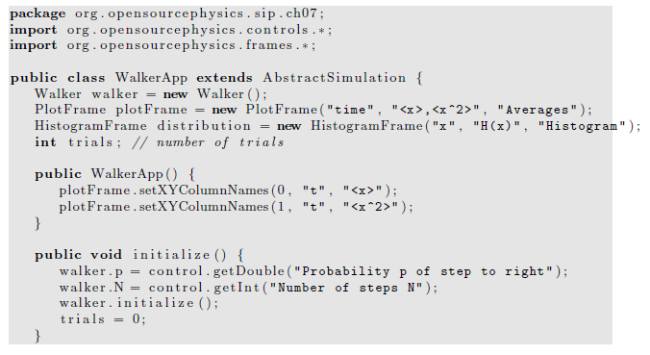

Slide 7
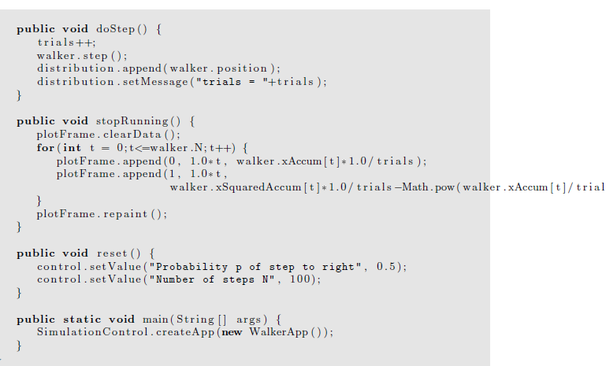
s,2)

Slide 8
The class WalkerApp displays the distribution of values of the displacement x after N steps.
One way of determining the number of times that the variable x has a certain value would be to define a one-dimensional array, probability, and let probability[x] += 1;
Any problems with this implementation?

Slide 9
In this case because x takes only integer values, the array index of probability is the same as x itself.
However, the above statement does not work in Java because x can be negative as well as positive.
What we need is a way of mapping the value x to a bin or index number.
The HistogramFrame class, which is part of the Open Source Physics display package, does this mapping automatically using the Java Hashtable class.

Slide 10
In simple data structures data is accessed by an index that indicates the location of the data in the data structure.
Hashtable data is accessed by a key, which in our case is the value of x.
A hashing function converts the key to an index.
The append method of the HistogramFrame class takes a value, finds the index using a hashing function, and then increments the data associated with that key.
The HistogramFrame class also draws itself.

Slide 11
The HistogramFrame class is very useful for taking a quick look at the distribution of values in a data set.
You do not need to know how to group the data into bins or the range of values of the data.
The default bin width is unity, but the bin width can be set using the setBinWidth method.
See WalkerApp for an example of the use of the HistogramFrame class.
Frequently, we wish to use the histogram data to compute other quantities.
You can collect the data using the Data Table menu item in HistogramFrame and copy the data to a file.
Another option is to include additional code in your program to analyze the data.
For more details, you can read the text book.

Slide 12
Further practice
Compute P_{N}(x), the probability that the displacement of the walker from the origin is x after N steps.
What is the difference between the histogram, that is, the number of occurrences, and the probability?
Consider N = 10 and N = 40 and at least 1000 trials.
Does the qualitative form of P_{N}(x) change as the number of trials increases?
What is the approximate width of P_{N}(x) and the value of P_{N}(x) at its maximum for each value of N?

Slide 13
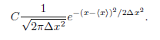
What is the approximate shape of the envelope of P_{N}(x)?
Does the shape change as N is increased?
Fit the envelope P_{N}(x) for sufficiently large N to the continuous function.

Slide 14
This form is the standard form of the Gaussian distribution with C = 1.
The easiest way to do this fit is to plot your results for P_{N}(x) and the form on the same graph using your results for ⟨x⟩ and Δx² as input parameters.
Visually choose the constant C to obtain a reasonable fit.
The lab 1, you will be asked to implement a more complicated random walk model, like 3D, uneven step size….
For more topics in random walk, you can also read the text book.

Slide 15
Method of Least Squares
The most common method for finding the best straight line fit to a series of measured points is called linear regression or least squares.
Suppose we have n pairs of measurements (x1, y1), (x2, y2), . . . , (xn, yn) and that the errors are entirely in the values of y.
For simplicity, we assume that the uncertainties in {yi} all have the same magnitude.
Our goal is to obtain the best fit to the linear function
y = mx + b.

Slide 16
The problem is to calculate the values of the parameters m and b for the best straight line through the n data points.
The difference,
d_{i} = y_{i} − mx_{i} − b
is a measure of the discrepancy in y_{i}.

Slide 17
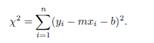
It is reasonable to assume that the best pair of values of m and b are those that minimize the quantity
Why should we minimize the sum of the squared differences between the experimental values, yi, and the analytical values, mx_{i}+b, and not some other function of the differences?

Slide 18
The justification is based on the assumption that if we did many simulations or measurements,
the values of d_{i} would be distributed according to the Gaussian distribution.
Based on this assumption, it can be shown that the values of m and b that minimize χ yield a set of values of mx_{i} +b that are the most probable set of measurements that we would find based on the available information.

Slide 19
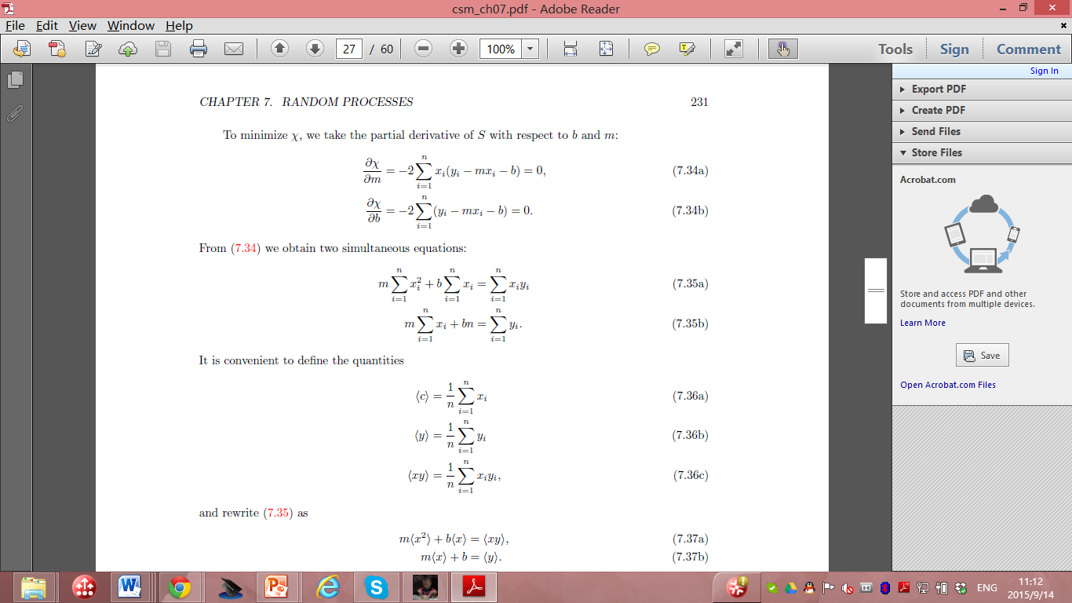
To minimize χ, we take the partial derivative with respect to b and m:

Slide 20
Then we obtain two equations:

Slide 21

It is convenient to define the quantities

Slide 22
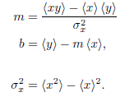
Rewrite the equation set as:
m⟨x²⟩ + b⟨x⟩ = ⟨xy⟩, m⟨x⟩ + b = ⟨y⟩.
The solution is:
Where:

Slide 23
the slope m and the intercept b of the best straight line through the n data points.
Example: consider the data shown in Table on next page for a one-dimensional random walk.
To make the example more interesting, suppose that the walker takes steps of length 1 or 2 with equal probability. The direction of the step is random and p = 1/2.

Slide 24
N Δx2
8 19.43
16 37.65
32 76.98
64 160.38
assume that the mean square displacement Δx² obeys the general relation Δx² = aN^{2γ},
with an unknown exponent ν and a is a constant.
Note that the fitting problem is nonlinear,
Often a problem that looks nonlinear can be turned into a linear problem by a change of variables.
In this case we convert the nonlinear relation to a linear relation by taking the logarithm of both sides:
ln(Δx²) = ln a + 2ν lnN.

Slide 25
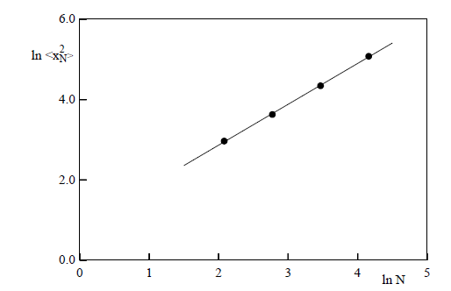
m = 1.02 and b = 0.83.
Hence, we conclude from our limited data and the relation 2ν = m that ν ≈ 0.51, which is consistent with the expected result ν = 1/2.

Slide 26

Random Number sequences
So far we have used the random number generator supplied with Java.
In principle, we could have generated these numbers from a random physical process, such as the decay of radioactive nuclei (refer to the text book for detailed discussions) or the thermal noise from a semiconductor device.
In practice, random number sequences are generated from a physical process only for specific purposes such as a lottery.

Slide 27
Although we could store the outcome of a random physical process so that the random number sequence would be both truly random and reproducible, such a method would usually be inconvenient and inefficient in part because we often require very long sequences.
In practice, we use a digital computer, a deterministic machine, to generate sequences of pseudorandom numbers.

Slide 28
such a distinction is unimportant if the sequence satisfies all our criteria for randomness.
Although these sequences cannot be truly random
Common to refer to random number generators
even though we really mean pseudorandom number generators.

Slide 29
Most random number generators yield a sequence
in which each number is used to find the succeeding one according to a well defined algorithm.
The most important features of a desirable random number generator:
its sequence satisfies the known statistical tests for randomness,
We also want the generator to be efficient and machine independent, and the sequence to be reproducible. (WHY?)

Slide 30
The most widely used random number generator:
linear congruential method.
One advantage
very fast.
For a given seed x0, each number in the sequence is determined by the one-dimensional map.
x_{n} = (ax_{n−1} + c) mod m

Slide 31
x_{n} = (ax_{n−1} + c) mod m
where a, c, and m as well as x_{n} are integers
The notation y = z mod m means that m is subtracted from z until 0 ≤ y < m.
the multiplier a, the increment c, and the modulus m
What’s the maximum possible period?

Slide 32
In general, the period depends on all three parameters.
For example, if a = 3, c = 4, m = 32, and x0 = 1, the sequence : 1, 7, 25, 15, 17, 23, 9, 31, 1, 7, 25,
The period is 8
rather than the maximum possible value of m = 32.
If we choose a, c, and m carefully such that the maximum period is obtained,
then all possible integers between 0 and m − 1 would occur in the sequence.

Slide 33
To have random numbers r in the unit interval 0 ≤ r < 1 rather than random integers, random number generators usually return the ratio x_{n}/m
which is always less than unity.
Several rules have been developed to obtain the longest period.

Slide 34
Another popular random number generator:
the generalized feedback shift register method,
bit manipulation.
Every integer is represented as a series of 1s and 0s called bits.
These bits can be shuffled by using the bitwise exclusive or operator ⊕ (xor) defined by a ⊕ b = 1 if the bits a≠ b; a ⊕ b = 0 if a = b.
The nth member of the sequence is given by
x_{n} = x_{n−p} ⊕ x_{n−q},

Slide 35
In Java and C the exclusive or operation on the integers m and n is written as mˆn.
The algorithm for producing the random numbers after p integers have been produced:
Initially the index, k, can be set to 0.
1. If k < q, set j = k + q, else set j = k − p + q.
2. Set x_{k} = x_{k} ⊕ x_{j} ; x_{k} is the desired random number for this iteration.
If a random number between 0 and 1 is desired, divide x_{k} by the maximum possible integer that the computer can hold.
3. Increment k to (k + 1) mod p.

Slide 36
Because the exclusive or operator and bit manipulation is very fast,
this random number generator is very fast.
However, the period may not be long enough for some applications and the correlations between numbers might not be as good as needed.

Slide 37
general nature:
numbers in the sequence are used to find the succeeding ones according to a well defined algorithm.
The sequence is determined by
the seed,
the first number of the sequence,
or the first p members of the sequence for the generalized feedback shift register and related generators.
Usually, the maximum possible period is related to the size of the computer word,
for example, 32, or 64 bits.
The choice of the constants and the proper initialization of the sequence is very important and thus these algorithms must be implemented with care.

Slide 38
no necessary and sufficient test for the randomness of a finite sequence of numbers;
It is apparently random.
Because no single statistical test is a reliable indicator, we need to consider several tests.
For details of the statistical tests, please read the textbook.

Slide 39
Many of these tests can be stated in terms of random walks.
Random walk. A test based on the properties of random walks has been proposed by Vattulainen et al.
Assume that a walker begins at the origin of the x-y plane and walks for N steps.
Average over M walkers and count the number of walks that end in each quadrant qi.
Use the χ2 test with y_{i} → q_{i}, M = 4, and E_{i} = M/4.
If χ2 > 7.815 (a 5% probability if the random number generator is perfect), we say that the run fails.
The random number generator fails if two out of three independent runs fail.
The probability of a perfect generator failing two out of three runs is approximately 3×0.95×(0.05)² ≈ 0.007.

Slide 40
Variational Methods
Many problems in physics can be formulated in terms of a variational principle.
How Monte Carlo methods can be applied to these problems?
A more sophisticated application of Monte Carlo methods to a variational problem in quantum mechanics will be discussed in the Monte Carlo chapter in PHYS4061.

Slide 41
Light rays
This description of light propagation, called geometrical or ray optics, is applicable when the wavelength of light is small compared to the linear dimensions of any obstacles or openings.
The path of a light ray can be formulated in terms of Fermat’s principle of least time: A ray of light follows the path between two points (consistent with any constraints) that requires the least amount of time.
Fermat’s principle can be adopted as the basis of geometrical optics.

Slide 42
For example, Fermat’s principle implies that light travels from a point A to a point B in a straight line in a homogeneous medium.
Because the speed of light is constant along any path within the medium, the path of shortest time is the path of shortest distance,
that is, a straight line from A to B.
What happens if we impose the constraint that the light must strike a mirror before reaching B?

Slide 43
The speed of light in a medium can be expressed in terms of c, the speed of light in a vacuum, and the index of refraction n of the medium : v =c / n
Suppose that a light ray in a medium with index of refraction n₁ passes through a second medium with index of refraction n₂.
The two media are separated by a plane surface.
We now show how we can use Fermat’s principle and a simple Monte Carlo method to find the path of the light.
The analytical solution to this problem using Fermat’s principle is found in many texts.

Slide 44
Our strategy, as implemented in class Fermat, is to begin with a straight path and to make changes in the path at random.
These changes are accepted only if they reduce the travel time of the light.

Slide 45
Some of the features of Fermat and FermatApp include:
1. Light propagates from left to right through N regions.
The index of refraction n[i] is uniform in each region [i].
The index i increases from left to right.
We have chosen units such that the speed of light in vacuum equals unity.
2. Because the light propagates in a straight line in each medium, the path of the light is given by the coordinates y[i] at each boundary.
3. The coordinates of the light source and the detector are at (0,y[0]) and (N,y[N]) respectively, where y[0] and y[N] are fixed.

Slide 46
4 The path is the connection of the set of points at the boundary of each region.
5. The path of the light is found by choosing the boundary i at random and generating a trial value of y[i] that differs from its previous value by a random number between -dy to dy.
If the trial value of y[i] yields a shorter travel time, this value becomes the new value for y[i].
6. The path is redrawn whenever it is changed.

Slide 47
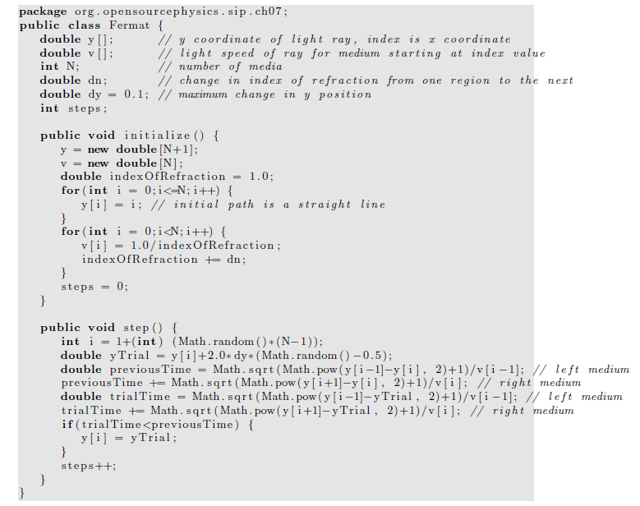

Slide 48
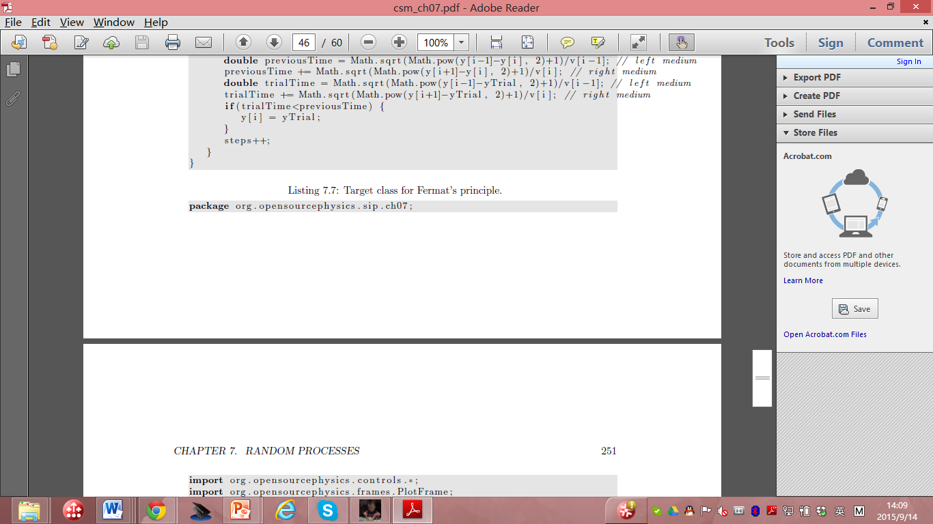

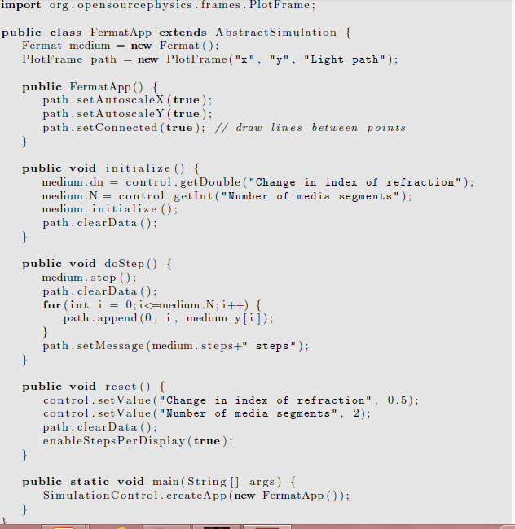

Slide 49
Modified Euler algorithms
Simple Euler algorithm is insufficient
The Euler algorithm assumes that the velocity and acceleration do not change significantly
during the time step Δt.
To achieve an acceptable numerical solution, Δt must be chosen to be sufficiently small!
What kind of physical systems may have large coupling between velocity and acceleration?
However, if we make Δt too small, we run into several problems.
Can you spot a few?

Slide 50
more and more iterations,
the round-off error accumulates
due to the finite precision of any floating point number
eventually the numerical results will become inaccurate.
Any solution on this?
The greater the number of iterations,
the greater the computer time required for the program to finish.
Unstable for many systems,
the errors accumulate exponentially,
the numerical solution becomes inaccurate very quickly.
Any solutions you can imagine to solve this problem?
For these reasons more accurate and stable numerical algorithms are necessary.

Slide 51
To illustrate why we need algorithms other than the simple Euler algorithm
a very simple change in the Euler algorithm:
v(t + Δt) = v(t) + a(t)Δt
y(t + Δt) = y(t) + v(t + Δt)Δt,
The only difference between this algorithm and the simple Euler:
v(t + Δt) = v(t) + a(t)Δt
y(t + Δt) = y(t) + v(t)Δt,
the computed velocity at v(t + Δt),
is used to compute the new position, y(t + Δt)
In what systems the latter velocity is generally more accurate?

Slide 52
this modified Euler algorithm is significantly better for oscillating systems.
We refer to this algorithm as
the Euler-Cromer algorithm.

Slide 53
It would be better to compute the velocity at the middle of the interval
rather than at the beginning or at the end.
The Euler-Richardson algorithm is based on this idea.

Slide 54
This algorithm is particularly useful for velocity-dependent forces
but does as well as other simple algorithms for forces that do not depend on the velocity.
The algorithm consists of using the Euler algorithm to find the intermediate position y_{mid} and velocity v_{mid} at a time t_{mid} = t + Δt/2.
We then compute the force, F(y_{mid}, v_{mid}, t_{mid}) and the acceleration a_{mid} at t = t_{mid}.
The new position y_{n+1} and velocity v_{n+1} at time t_{n+1} are found using v_{mid} and a_{mid} and the Euler algorithm.

Slide 55
Euler-Richardson algorithm:
a_{n} = F(y_{n}, v_{n}, t_{n})/m
v_{mid} = v_{n} +1/2 a_{n}Δt
y_{mid} = y_{n} +1/2 v_{n}Δt
a_{mid} = F(y_{mid}, v_{mid}, t +1/2 Δt)/m,
v_{n+1} = v_{n} + a_{mid}Δt
y_{n+1} = y_{n} + v_{mid}Δt

Slide 56
Although we need to do twice as many computations per time step,
the Euler-Richardson algorithm is much faster than the Euler algorithm
because we can make the time step larger
still obtain better accuracy than with either the Euler or Euler-Cromer algorithms
What’s the fundamental idea of this algorithm?

Slide 57
Effects of Drag Resistance
A projectile on the surface of the Earth with no air friction,
Including a plot of position versus time and an animation of a projectile moving through the air.

Slide 58
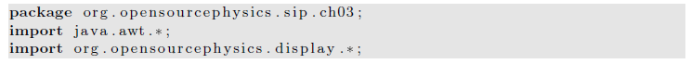
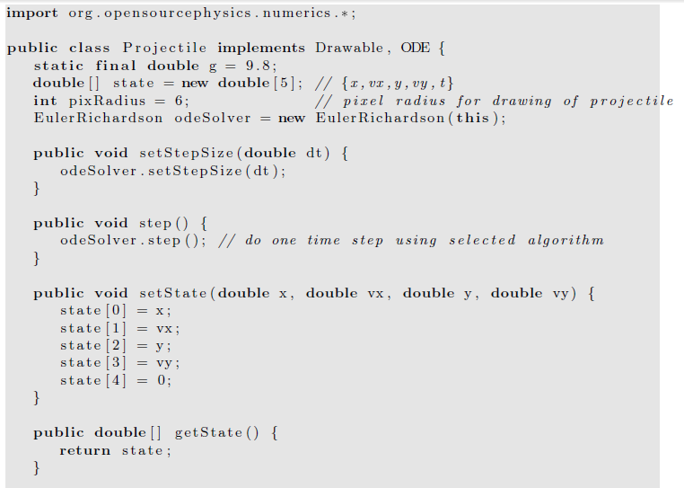

Slide 59
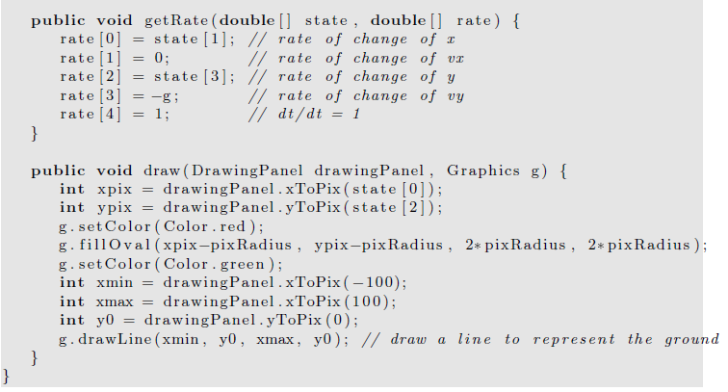

Slide 60
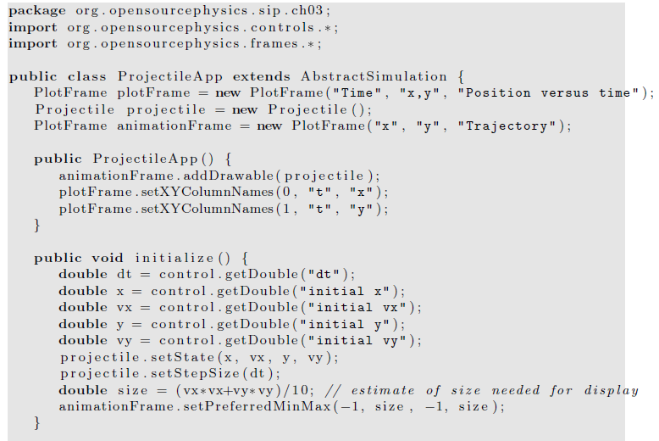

Slide 61
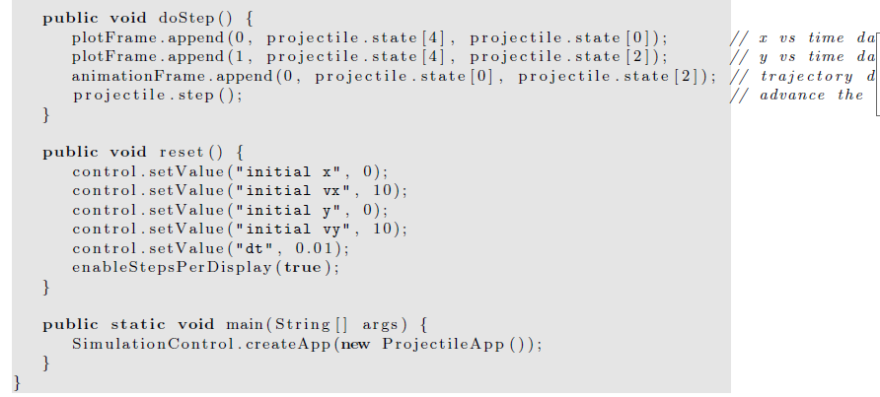

Slide 62
For particles near the Earth’s surface,
an more important modification is to include the drag force due to air resistance.
The direction of the drag force F_{d}(v) is opposite to the velocity of the particle
For a falling body F_{d}(v) is upward
Hence, the total force F on the falling body can be expressed as
F = -mg + F_{d}.
What’s the final constant velocity?
How can we measure the drag force?

Slide 63
The velocity dependence of F_{d}(v) is known theoretically
in the limit of very low speeds for small objects.
In general, necessary to determine the velocity dependence of F_{d}(v) empirically over a limited range of velocities.
One way to obtain the form of F_{d}(v) is to measure y as a function of t
and compute v(t) by calculating the numerical derivative of y(t).

Slide 64
Similarly we can use v(t) to compute a(t) numerically.
From this information it is possible in principle to find the acceleration as a function of v and to extract Fd(v).
errors because the accuracy of the derivatives will be less than the accuracy of the measured position.
An alternative is to reverse the procedure
assume an explicit form for the v dependence of Fd(v),
use it to solve for y(t).
If the calculated values of y(t) are consistent with the experimental values of y(t),
the assumed v dependence of Fd(v) is justified empirically.

Slide 65
The two common assumed forms of the velocity dependence of Fd(v) are
F_{1,d}(v) = C₁v,
F_{2,d}(v) = C₂v²,
the parameters C₁ and C₂ depend on the properties of the medium and the shape of the object.
useful phenomenological expressions
yield approximate results for F_{d}(v) over a limited range of v

Slide 66
Because F_{d}(v) increases as v increases,
there is a limiting or terminal velocity (speed)
the net force on a falling object is zero.
This terminal speed can be found by setting F_{d} = mg and is given by
v_{1,t} =mg/C₁ (linear drag)
v_{2,t} =(mg/C₂)^{1/2} (quadratic drag)

Slide 67
write F_{d} in the linear and quadratic cases as
F_{1,d} = C₁v_{1,t}( v / v_{1,t})= mgv/v_{1,t}
F_{2,d} = C₂v_{2,t}²( v/v_{2,t})²= mg( v/v_{2,t})²
the net force (per unit mass) on a falling object in the convenient forms
F₁ (v)/m= - g(1-v/v_{1,t})
F₂ (v)/m= -g(1- v²/v_{2,t}²)

Slide 68
Consider the fall of a pebble of mass m = 10⁻² kg.
To a good approximation, the drag force is proportional to v².
For a spherical pebble of radius 0.01 m, C₂ is found empirically to be approximately 10⁻² kg/m.
The terminal velocity to be about 30 m/s.

